Slide 1

CAPSTONE PROJECT · SECURE CODE ANALYSIS
COMPILENS
Compiler-Based Secure Source Code Analysis Framework for Syntax, Semantic and Runtime Error Detection
Presented by
[NITHYA SHREE – 192521145]
[HEMALATHA C – 192524475]
[SANJAY – 192521025]
Under the Guidance of: [Dr. KARTHIKA PRIYA]
Department of [B.TECH IT & AIDS ] · SIMATS Engineering

Slide 2
COMPILENS / 01 INTRODUCTION
One program.
Many failure points.
SYNTAX
• Software errors emerge at different stages of development.
• Traditional compilers mainly focus on translation-time checks.
• Developers often switch between debuggers, linters, scanners, and runtime tools.
• Using multiple tools makes debugging and error identification more complex.
• COMPILENS unifies syntax, semantic, security, and runtime analysis in one platform.
SEMANTIC
SECURITY
COMPILENS unifies these stages in one analysis path.
RUNTIME

Slide 3
COMPILENS / 02 ABSTRACT
Four analyses.
One compiler-driven lens.
COMPILENS is a unified framework for secure source code analysis.
Detects lexical and syntax errors through Module 1.
Performs semantic and security analysis through Module 2.
Identifies potential runtime errors through Module 3.
Integrates all findings into a single analysis report to improve code quality and secure coding.

Slide 4
COMPILENS / 03 PROBLEM STATEMENT
From toolchain friction
to a single analysis surface
EXISTING REALITY
PROPOSED SYSTEM
Different error types
Fragmented specialist tools
Delayed debugging feedback
Security checks outside the compiler
Integrated compiler framework
Syntax + semantic validation
Security vulnerability detection
Runtime monitoring + one report
4 TOOLS → 4 DISCONNECTED OUTPUTS
COMPILENS → UNIFIED RESULT

Slide 5
COMPILENS / 04 LITERATURE REVIEW
Research signals—and the gap
Aho et al. (2006)
Compiler phases and formal analysis foundations.
Ayewah et al. (2008)
FindBugs: practical static bug pattern detection.
Lattner & Adve (2004)
LLVM: reusable compiler infrastructure.
Livshits & Lam (2005)
Static detection of security vulnerabilities.
Nethercote & Seward (2007)
Valgrind: dynamic binary instrumentation.
Sadowski et al. (2015)
Large-scale industrial static analysis.
NIST (2022)
SSDF guidance for secure development.
RESEARCH GAP
Most approaches isolate one stage; COMPILENS integrates syntax, semantics, security and runtime evidence.

Slide 6
COMPILENS / 05 PROJECT OBJECTIVES
Three modules. One objective:
trustworthy code.
01 PARSE
02 VERIFY
03 OBSERVE
Semantic validation
Security vulnerability detection
Actionable diagnostics
Runtime error detection
Cross-stage correlation
Unified reporting
Lexical tokenization
Syntax error detection
Precise source locations

Slide 7
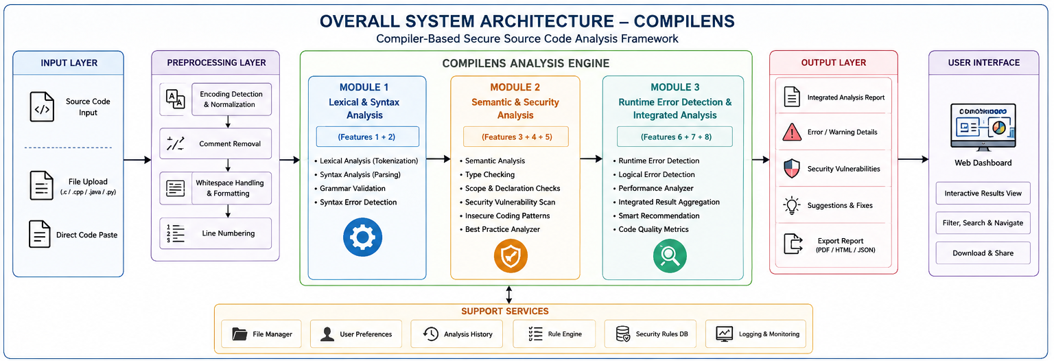
COMPILENS / 06 SYSTEM ARCHITECTURE
Analysis flows forward.
Evidence comes together.
SOURCE CODE
INPUT
COMPILENS
ENGINE
M1 SYNTAX
M2 SEMANTIC + SECURITY
M3 RUNTIME
INTEGRATED
RESULTS
ERROR
REPORT
MODULE FEATURES
M1 Tokens + grammar · M2 Types + vulnerabilities · M3 Runtime events + correlation

Slide 8
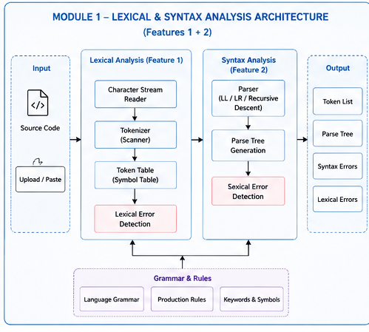
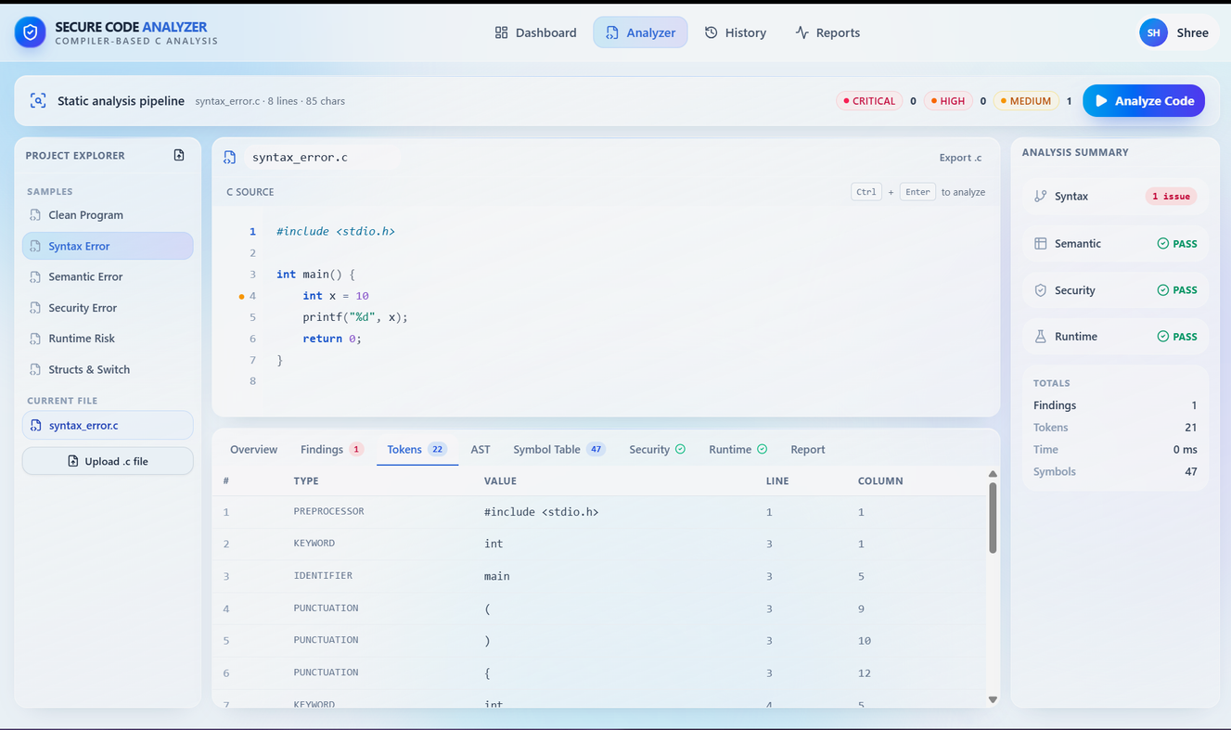
Lexical & Syntax Analysis
MODULE 1
Accepts and processes the source code input.
Breaks the code into tokens using lexical analysis.
Identifies invalid characters and lexical errors.
Validates program structure using syntax analysis.
Detects and reports syntax and grammatical errors.

Slide 9
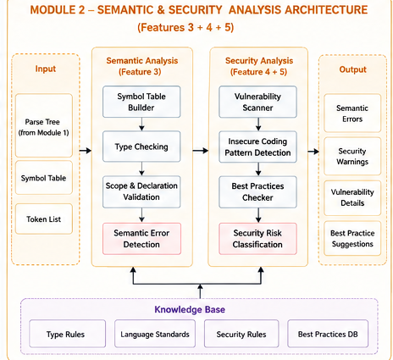
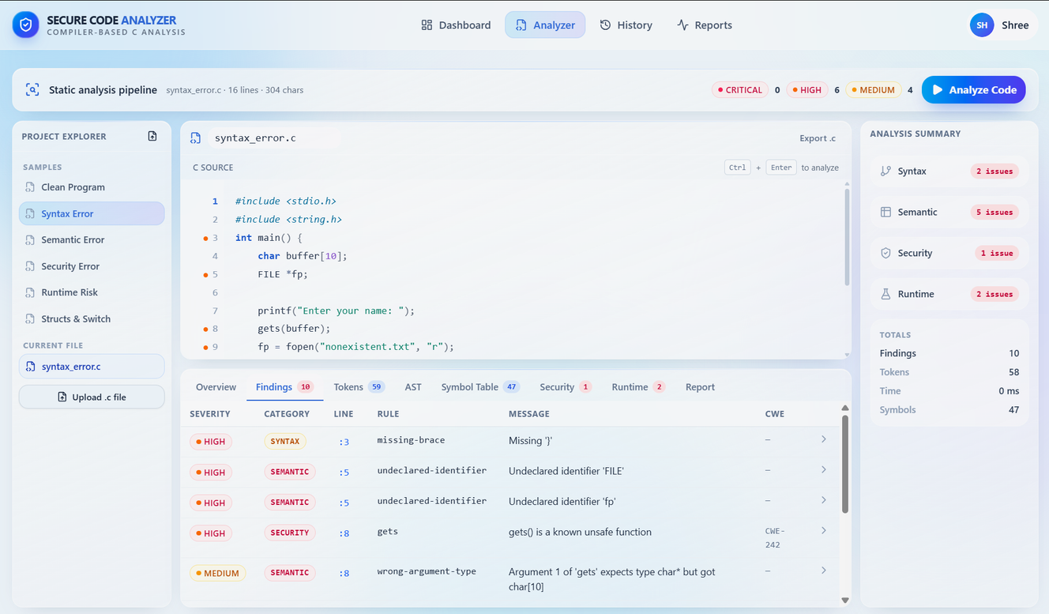
Semantic & Security Analysis
MODULE 2
Checks the logical meaning of the source code.
Performs type and declaration validation.
Identifies semantic inconsistencies and errors.
Detects selected security vulnerabilities.
Provides secure coding suggestions and best practices.

Slide 10
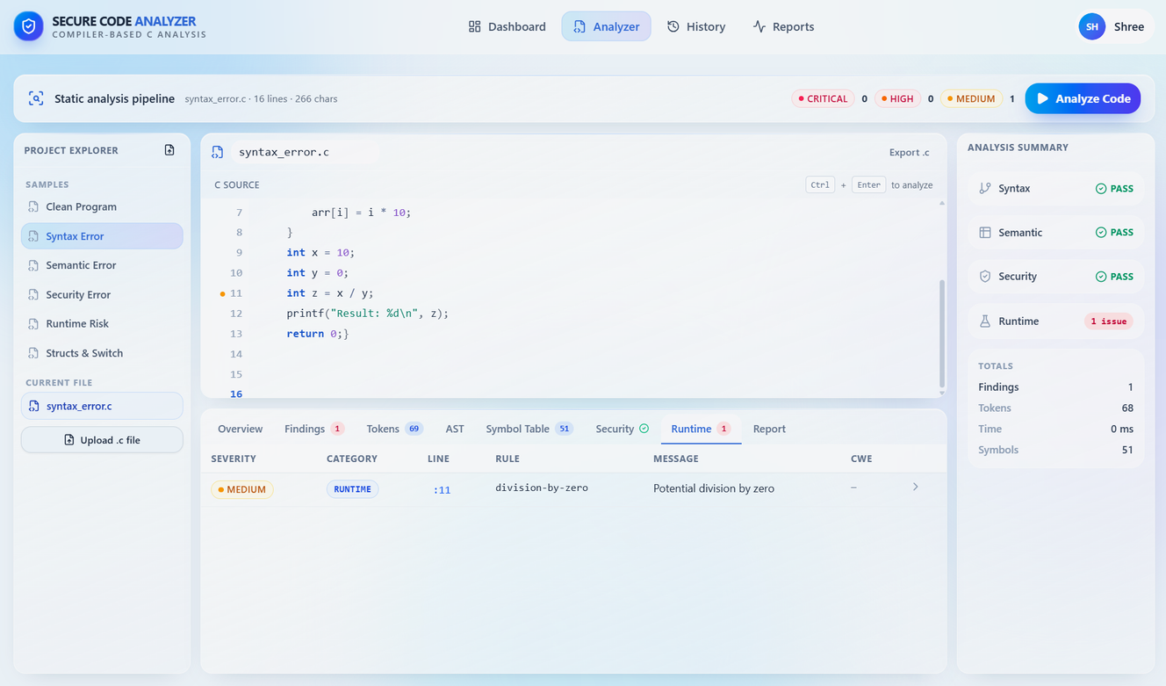
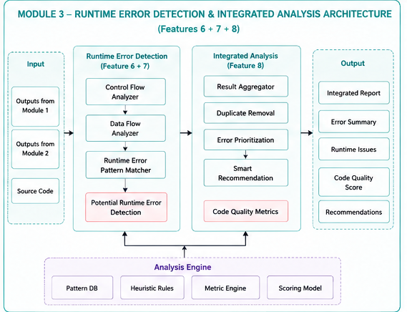
Runtime Error Detection & Integrated Analysis
MODULE 3
Analyses potential errors that may occur during execution.
Identifies common runtime error patterns.
Collects findings from all three analysis stages.
Removes duplicate findings and prioritizes errors.
Generates an integrated analysis report with recommendations.

Slide 11
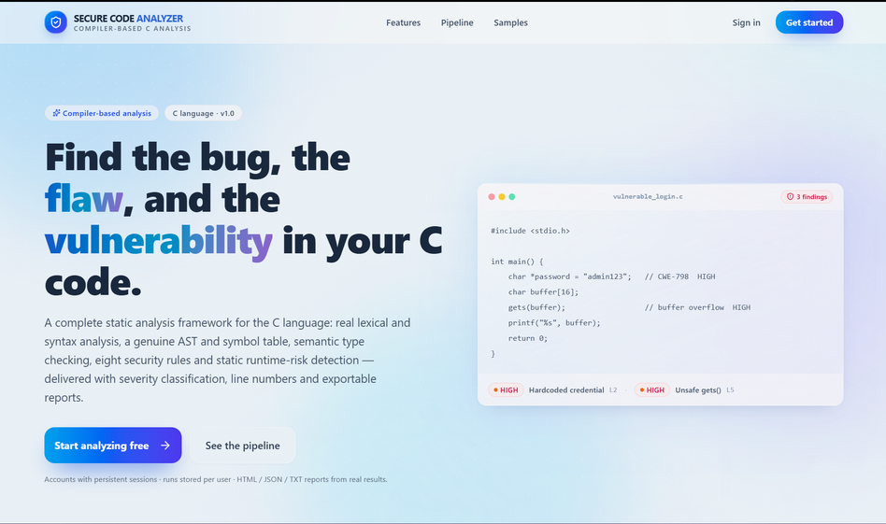
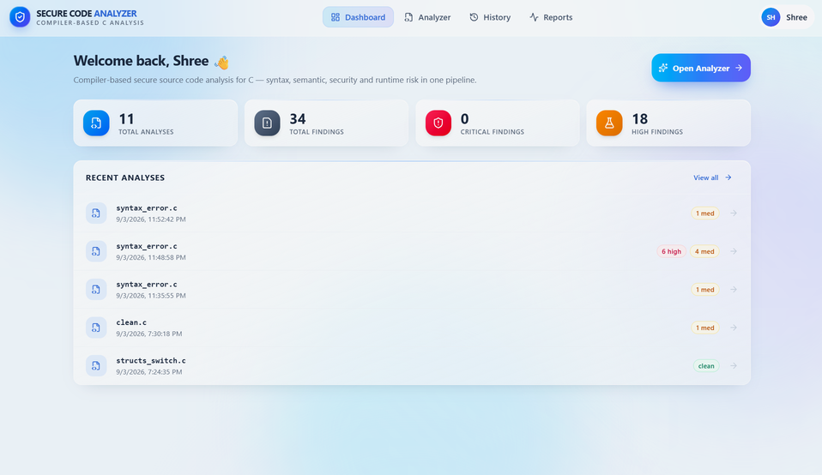
COMPILENS / 07 RESULTS
A unified result,
not another tool window.
Multi-stage analysis identifies syntax, semantic, security and runtime issues, then categorizes findings in a single reporting surface.
KEY OUTCOME
Compiler principles + security analysis + runtime evidence in one framework.

Slide 12
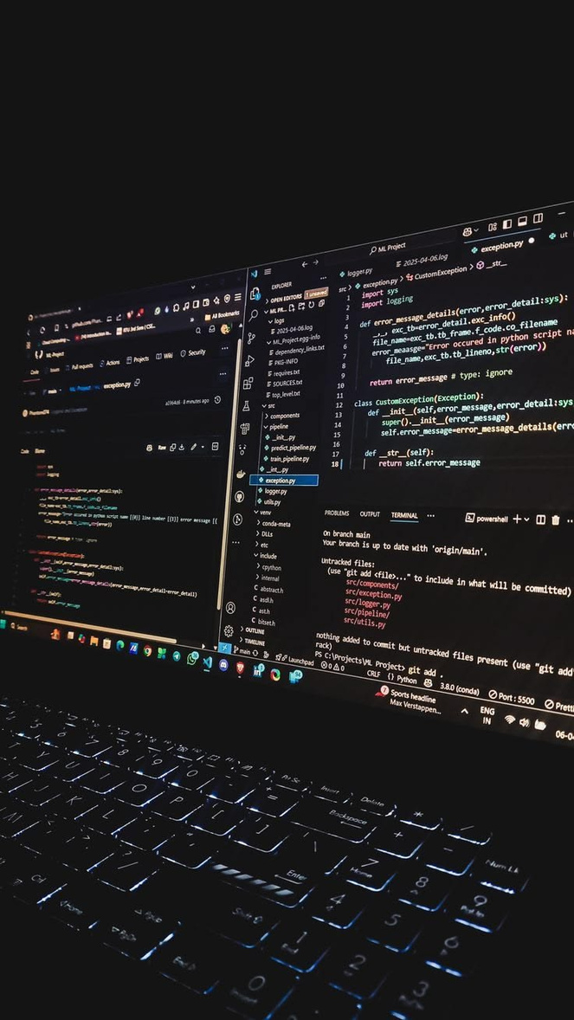
COMPILENS / 08 CONCLUSION
One lens for
safer software.
COMPILENS brings three coordinated modules into one source-code analysis workflow—improving code quality, identifying issues earlier and reducing the distance between detection and resolution.

Slide 13

COMPILENS / 09 FUTURE SCOPE
From framework
to intelligent platform.
Multi-language support · IDE integration
AI-powered explanations · Automatic corrections
Advanced vulnerability detection · ML error prediction
Real-time analysis · Cloud collaboration
Runtime monitoring · GitHub + CI/CD integration
VISION / An AI-powered, multi-language secure development companion.

Slide 14
COMPILENS / 10 REFERENCES
Selected foundations
1. Aho, A. V. et al. (2006). Compilers: Principles, Techniques, and Tools. Pearson.
2. Ayewah, N. et al. (2008). Using static analysis to find bugs. IEEE Software, 25(5).
3. Lattner, C., & Adve, V. (2004). LLVM: A compilation framework. CGO.
4. Livshits, V., & Lam, M. (2005). Finding security vulnerabilities in Java. USENIX Security.
5. Nethercote, N., & Seward, J. (2007). Valgrind. PLDI.
6. Sadowski, C. et al. (2015). Tricorder: Building a program analysis ecosystem. ICSE.
7. NIST. (2022). Secure Software Development Framework (SSDF), SP 800-218.
Together, these works support combined static, semantic, security and dynamic analysis—while highlighting practical concerns such as scalability and false positives.

Slide 15
QUESTIONS & DISCUSSION
THANK YOU
COMPILENS
“Analyse. Detect. Secure.”

